Slide 1
CM4701 - Human Computer Interaction
Week 8: Cognitive Evaluation
Carlos Moreno-García

Slide 2


Optimising Interfaces
To optimise interfaces, we need to minimise the cognitive load!
People spend more time in software use every day
According to latest pools from uSwitch.com, an average adult spends over 30 hours a week browsing the Internet, increasing to 45 hours for young adults i.e. 18-24 years old.

Slide 3
Optimising Interfaces
New guidelines for designing usable interfaces such as Web Content Accesibility Guidelines (WCAG) recommend reducing short term memory load.
Cognitive load, i.e. working memory requests during problem solving, reasoning, or thinking or when moving a limb such as a hand, may affect users’ general satisfaction and performance when completing tasks such as browsing an internet web application¹.
In this paper, Schmutz et al. addresses some of points mentioned above.
¹ This includes motor functions which are only possible after some cognitive processes

Slide 4
Optimising Interfaces
Optimisation often is based on human testing, however it is:
Time consuming
Expensive
Slow processing
Many participants must be involved
Many tests must be completed by participants
Difficult to integrate into software development

Slide 5
Optimising Interfaces
There are other methods. Using cognitive architectures is:
Fast in processing
Easier as no participants are involved
Not expensive
Easy to integrate into software development
Difficult to model human motor and cognitive functions

Slide 6
Optimising Interfaces
Methods to model user interaction have been researched for many decades.
In 1983, Stuart Card developed the GOMS (Goals, Operators, Methods, and Selection) rules. They also developed another form of GOMS called Keystroke-Level Model (KLM) which is simpler, easier to use and more adapted to HCI i.e. computer interfaces.
KLM allows for time prediction for completion of tasks. These widely used modelling systems reduce a user’s interaction to their basic components, involving physical, cognitive and perceptual actions.
They can be analysed
Optimisation can be achieved through them.

Slide 7
7.2.1. ACT-R
Notes:
-ACT-R: Adaptive Control of Thought — Rational

Slide 8
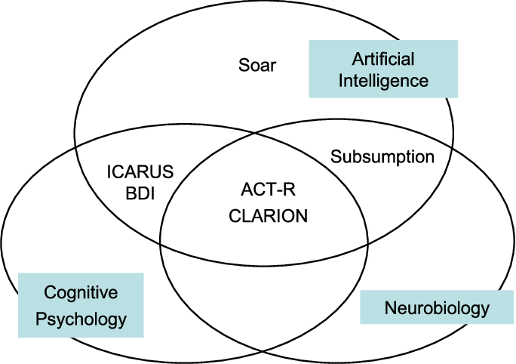
Cognitive Architectures
Notes:
-ACT-R: Adaptive Control of Thought — Rational
-CLARION: Connectionist Learning with Adaptive Rule Induction On-line (another architecture)

Slide 9

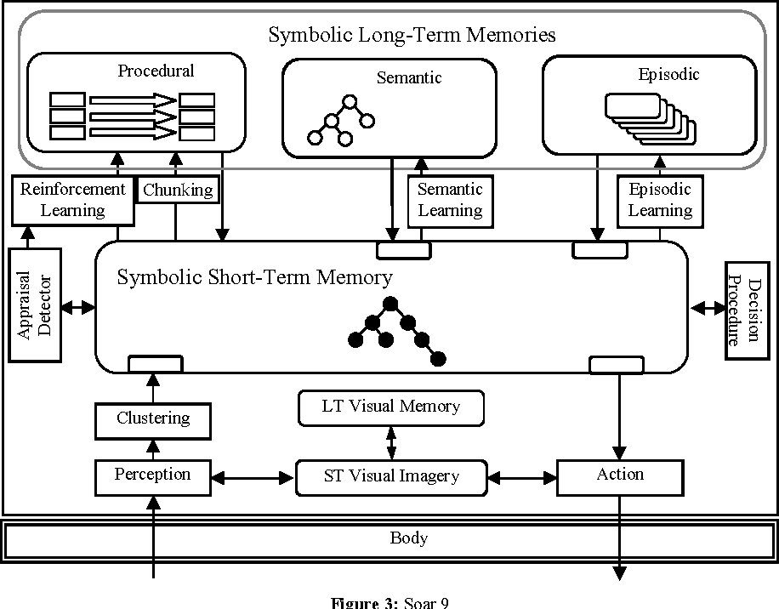
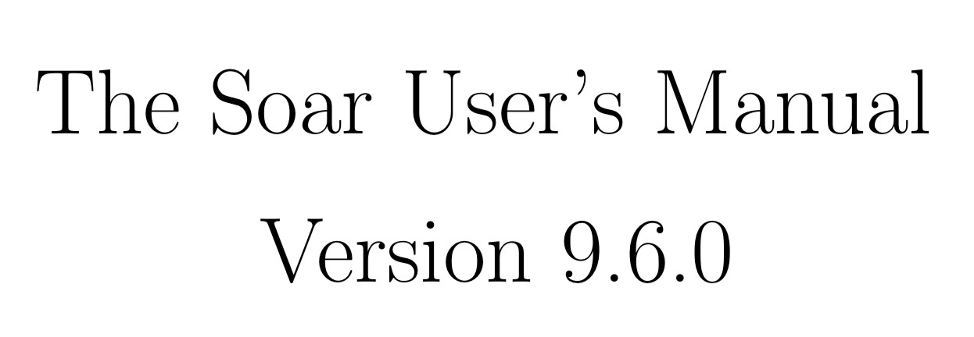
SOAR
First mentioned by Allen Newell in 1972, SOAR was the first attempt (1983) to produce an Unified Theory of human cognition.
It is capable of simulating human learning, reasoning, skill acquisition and mental processes.
SOAR is widely used in research involving the understanding of human cognition.
https://soar.eecs.umich.edu/downloads/Documentation/SoarManual.pdf

Slide 10
Atomic Control of Though - Rational (ACT-R)
Inspired by the work of Newell et al.¹ and Lebiere et al., who later devoted their research to create a universal theory of cognition which underpin ACT-R.
Later, this framework was completed with the addition of human motor functions to become ACT-R/PM.
ACT-R uses the Fitt’s law as part of its latency calculations².
ACT-R/PM is used in many research areas, such as military and medical applications.
¹ Started with HAM, followed by ACT, he then went on to develop ACT-R which then was followed by ACT-R/PM
² In short, smaller and further is the target object to go to and higher will be the timing
Notes:
-PM: Perceptual Motor

Slide 11
ACT-R/PM
•
ACT-R is a cognitive architecture: a theory for simulating and understanding human cognition as well as simple motor functions. It also contains audible and visual functions that are well developed.
Researchers working on ACT-R strive to understand how people organise knowledge and produce intelligent and rational behaviour.
As research continues, ACT-R evolves ever closer into a system which can perform the full range of human cognitive tasks i.e. capturing in granular detail the way we (human) perceive, think about, and act on the world the way we do.
Theory about how human cognition works based on assumptions on numerous facts derived from psychology experiments.
•
•
•

Slide 12
ACT-R/PM
•
ACT-R is like a programming language; a framework where researchers create models (i.e. programs) that are written in ACT-R and that, beside incorporating the ACT-R’s view of cognition embedded in this architecture, add their own assumptions about the particular task.
These assumptions can be tested by comparing the results of the model with the results of people doing the same tasks.
By “results” we mean the traditional measures of cognitive psychology i.e. time to perform the task and accuracy in the task etc.

Slide 13
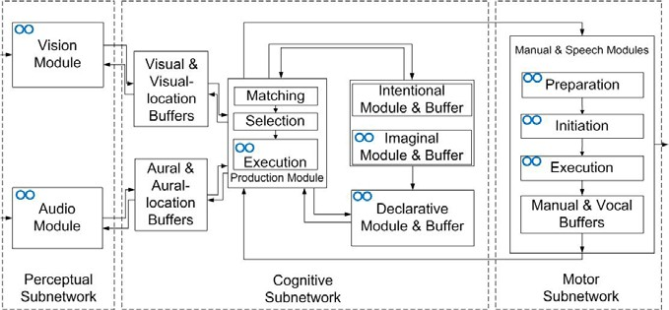
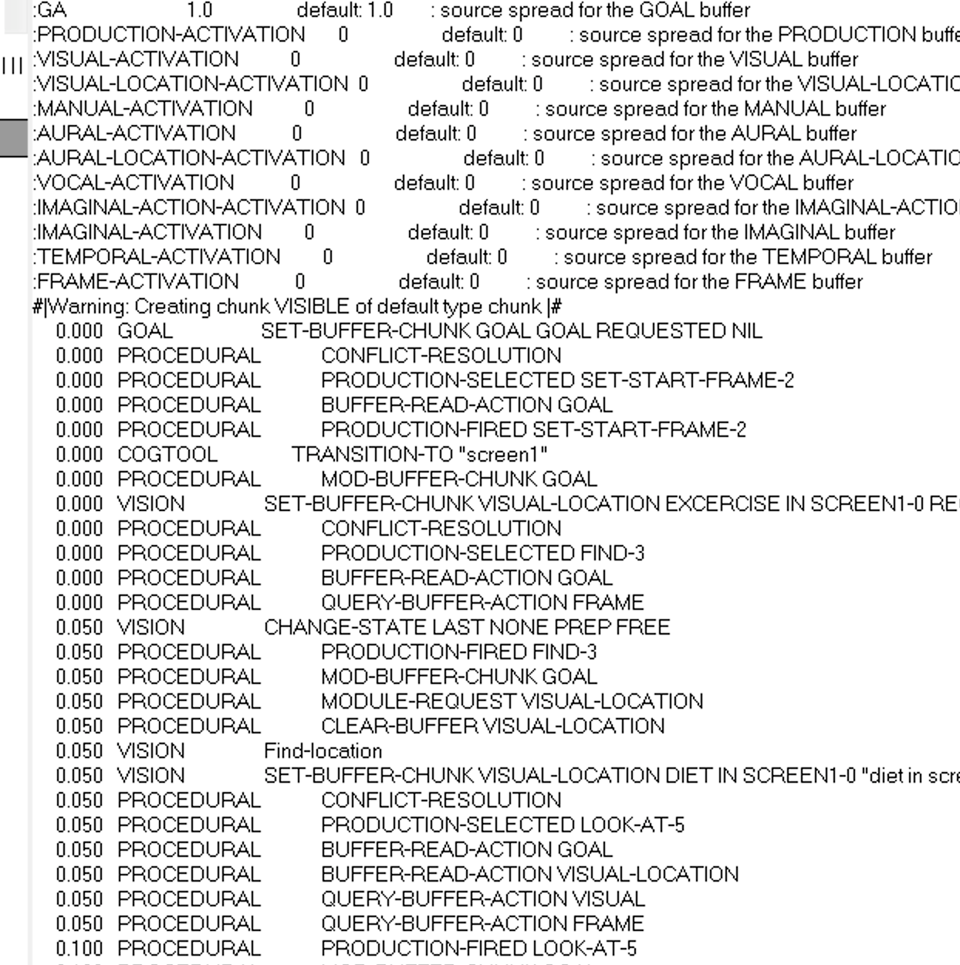
ACT-R/PM Example

Slide 14
ACT-Simple
Developed by Salvucci et al. in 2003¹, merges the concepts of KLM and ACT-R in one environment.
User interaction is analysed and produces KLM rules which are then translated into an ACT-R model to simulate human cognitive, motor and visual functions for a scenario of tasks. It returns a latency (timing) for this series of tasks.
It is much easier than modelling KLM and ACT-R, but it is still a challenging environment to use.
In 2004, Bonnie John created a prototyping interface called CogTool in which user interaction is modelled by demonstration using ACT-Simple.
¹ACT-Simple is widely used in research for both hardware and software interfaces

Slide 15
7.2.1.1. CogTool

Slide 16
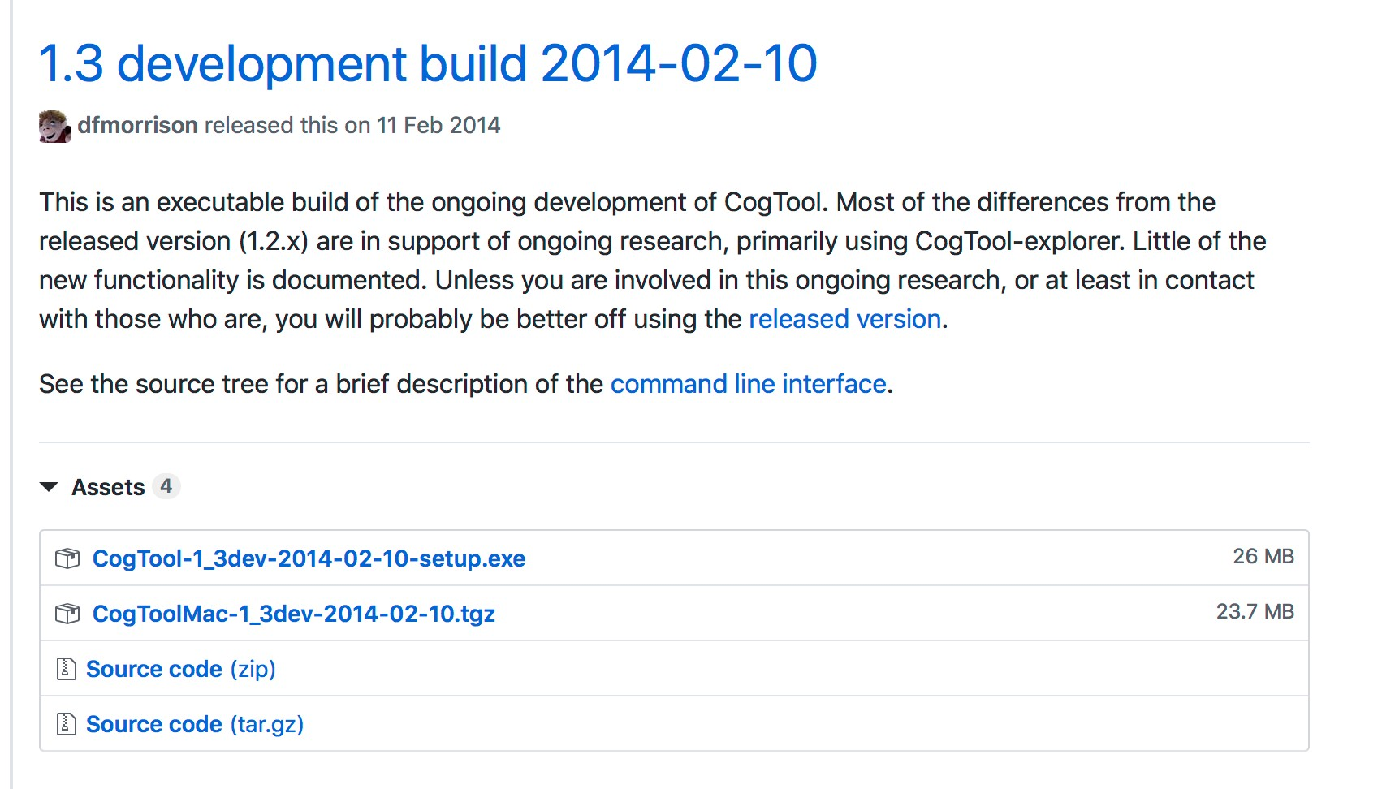
CogTool
CogTool is relatively simple to use and is based on the idea of using sketches and storyboards to demonstrate the user interaction.
It was available for free originally at the Carnegie Mellon University¹ but can now be downloaded from GitHub
https://github.com/cogtool/cogtool/releases
¹Carnegie University is well-known for its research in human cognition as well as developing ACT-R.

Slide 17
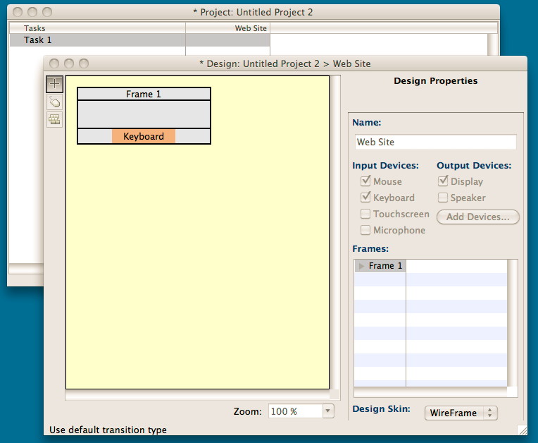
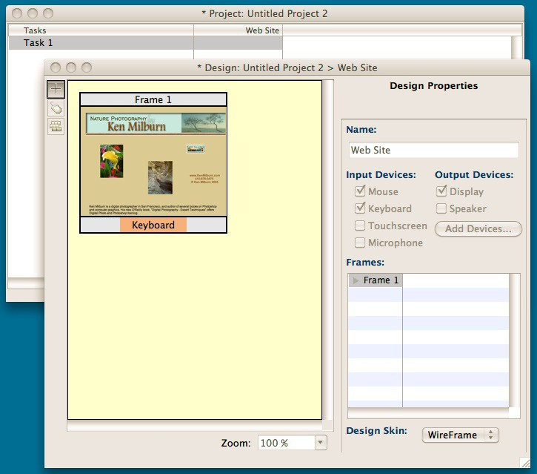
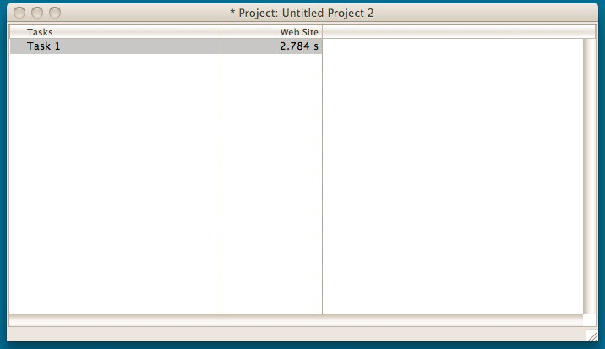
CogTool
First we create a project in CogTool. The scenario we wish to have is:
The background image has been set to a screenshot of the web page we want to test
•
•
•
Look at flower picture
Look at river picture
Click on the “Enter Gallery” link
Once the user interaction has been setup in CogTool, we can compute the simulated time to achieve the tasks. For this experiment, it is 2.784 second

Slide 18
8. Storyboarding

Slide 19
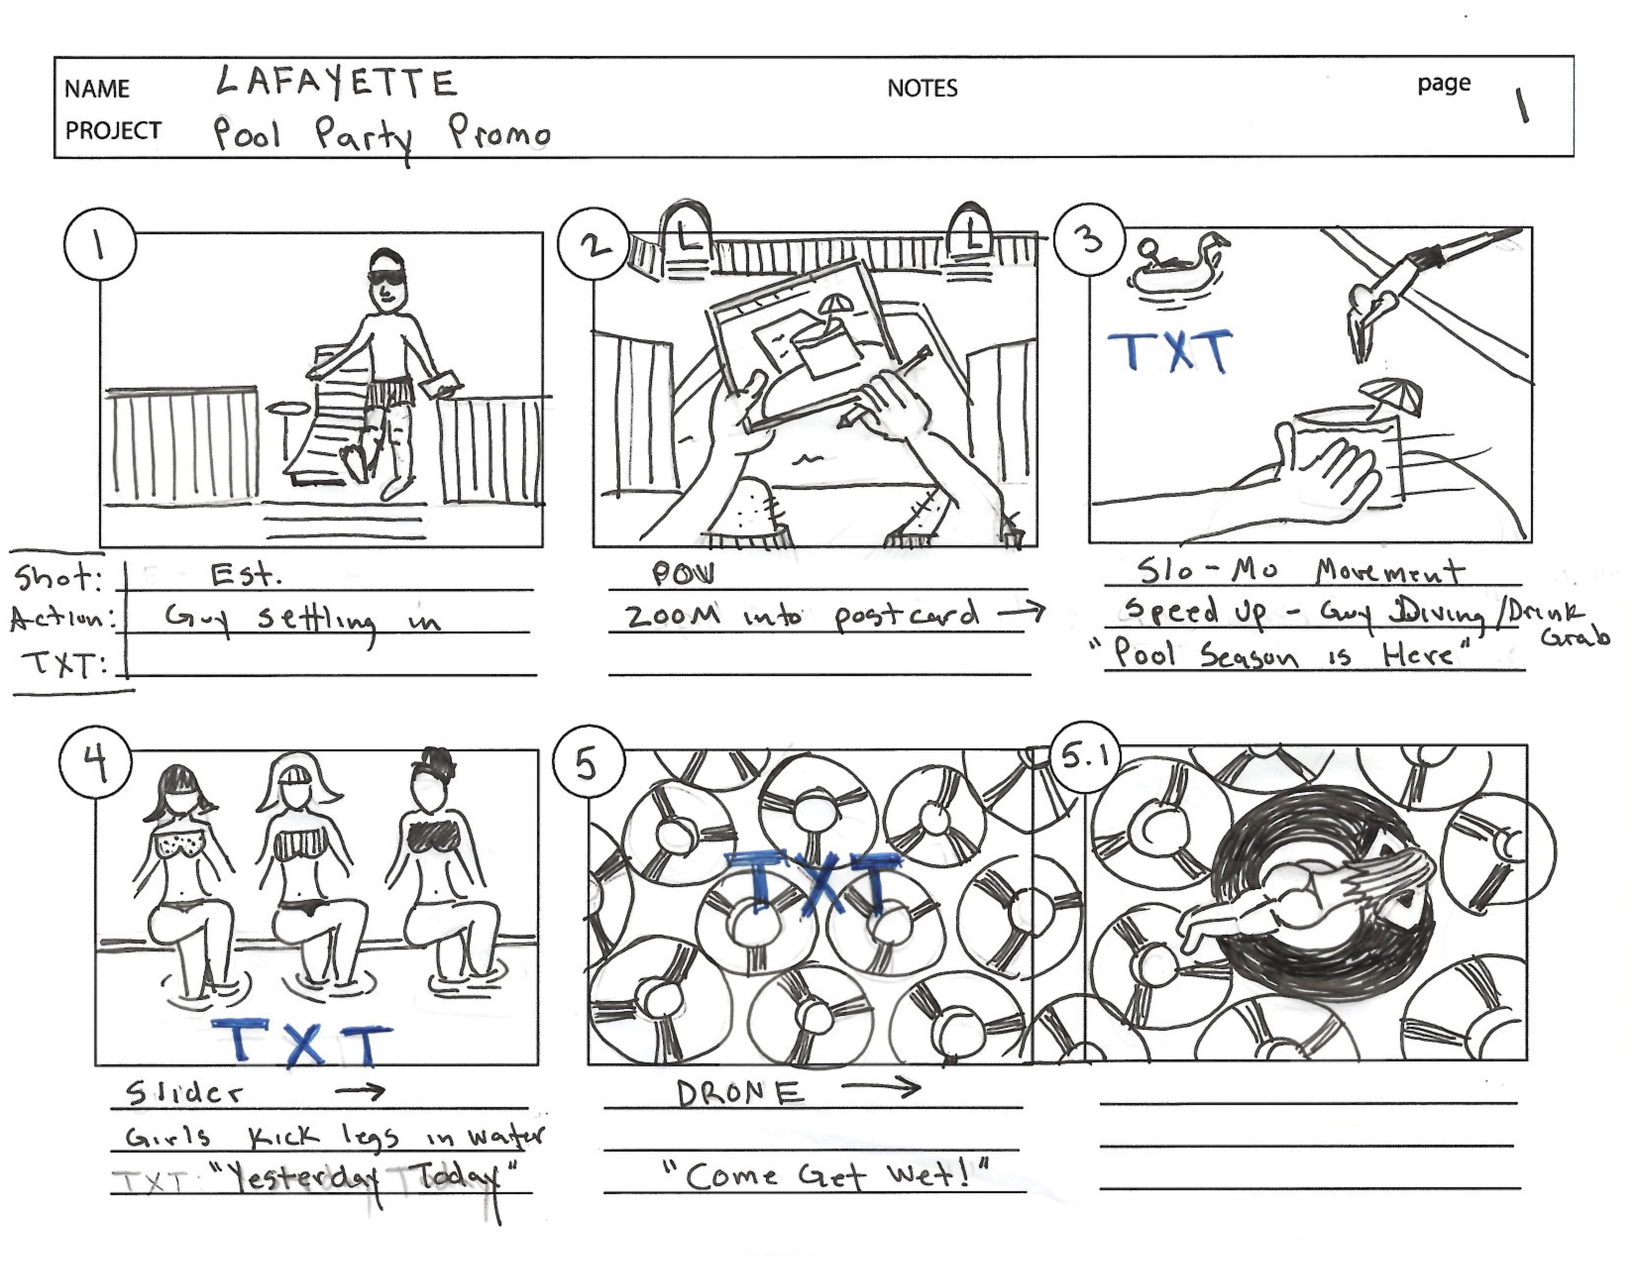
Storyboards
Series of sketches showing how a user might interact with the technology / app / device / website / etc., or to show the progress through a series of tasks
Often used with a scenario to bring in more detail and context.
A storyboard often contains elements such as background, text fonts used, widgets and design components used, if any multimedia components are used such as videos, animations etc.
Can use pen and paper screenshots, PowerPoint slides, screenshots, etc.

Slide 20
Storyboards
Pros
Simple to design by yourself
Do not need technical knowledge
Pushes to think through the process of how proposed device/app will be used and helpful to identify needed features
Very useful for communicating ideas of concept
Cons
Rough representations/sketches
Not everything can go in, often main components only
Limited in scope, and at times can be impractical to use on a whole project

Slide 21
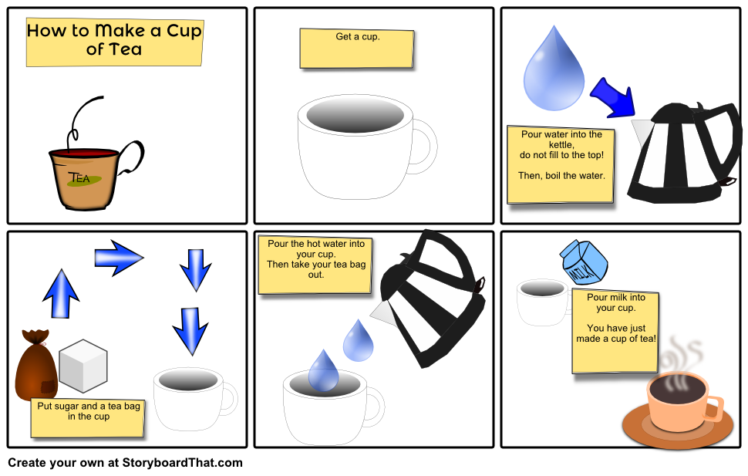
Storyboarding - Sketching
Notes:
-Having HTA in mind is good!

Slide 22
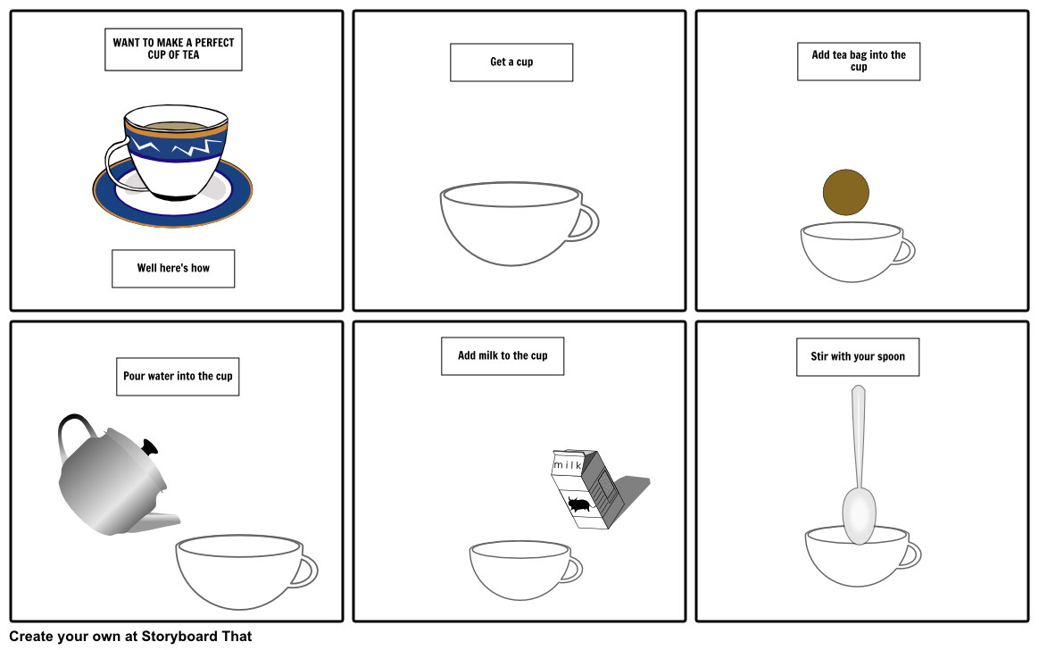
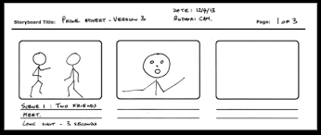
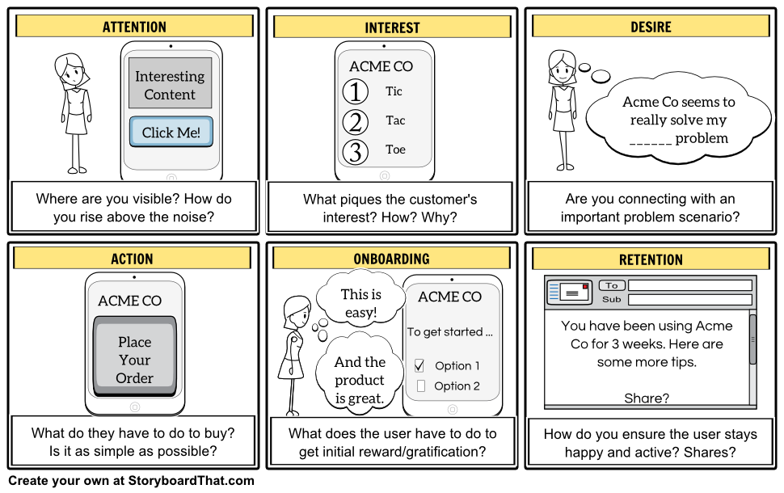
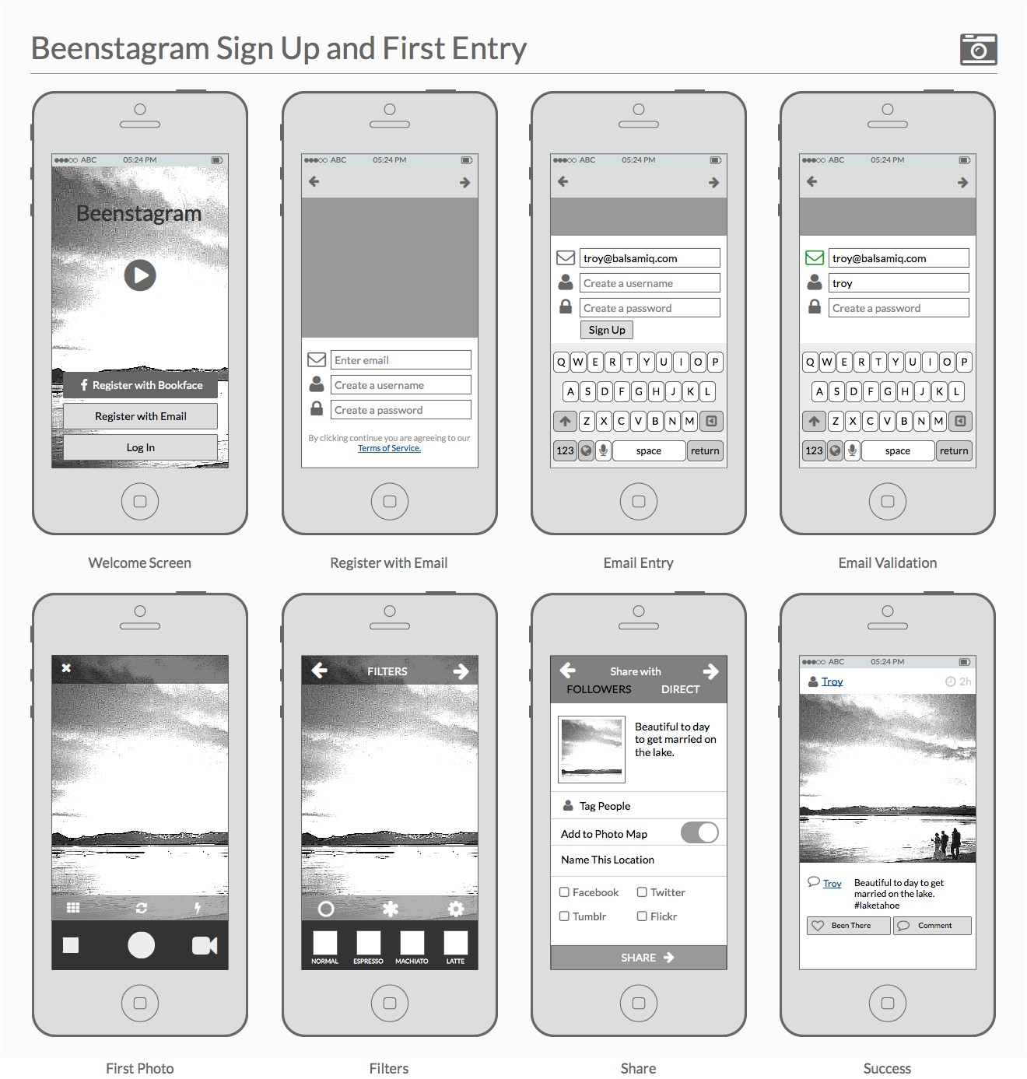
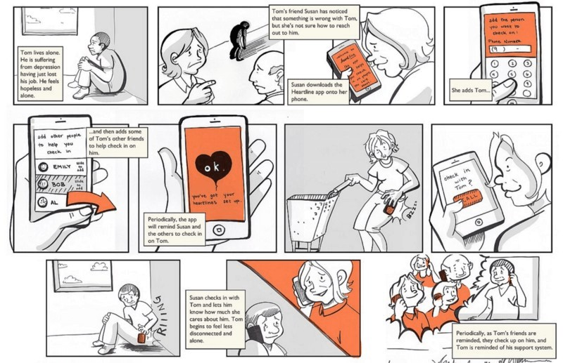
Storyboarding - Examples
https://sbt.blob.core.windows.net/storyboards/alexcowan/customer-acquisition-storyboard
--aida-or--example2.png
https://media.balsamiq.com/img/blogs/ux/example-beenstagram-storyboard-2.png

Slide 23
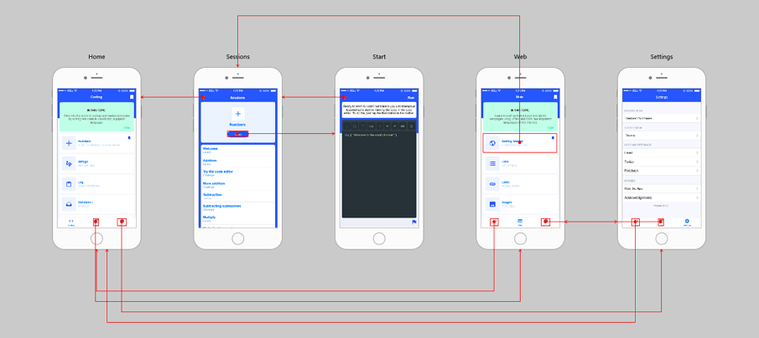
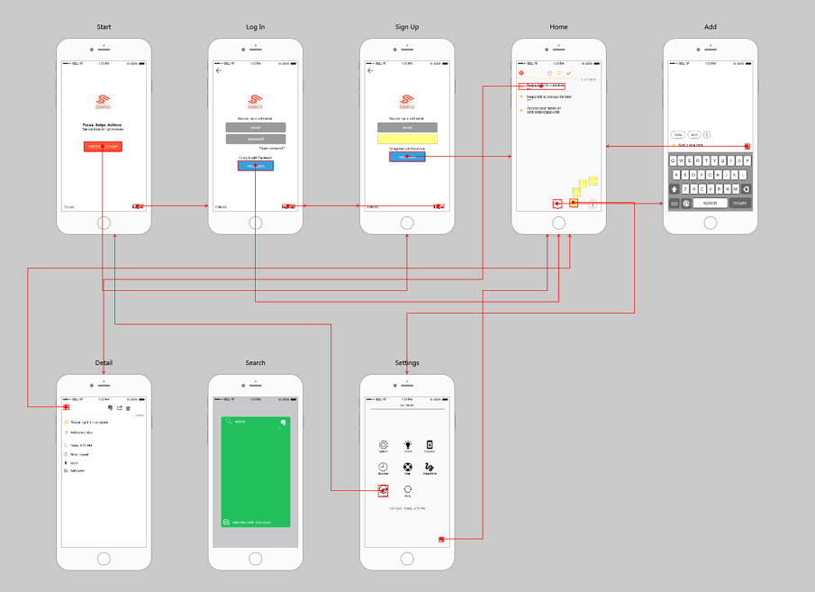
Storyboarding - Examples
https://file.mockplus.com/image/2018/03/ef08b01e-3461-4833-9e23-a50663989b0e.png
https://file.mockplus.com/image/2018/03/0fd1f9b7-a3b1-4a80-ba15-ed1324af72a7.png
Notes:
-More CogTool friendly!

Slide 24
CogTool Demos You will find all the material in Moodle

